Slide 1
Bayesian Classification(or Naïve Bayesian classifier)

Slide 2
Bayesian classification is a statistical technique used to classify the data based on probabilistic reasoning.
It is a type of probabilistic classification that uses Bayes' theorem to predict the probability of a data point belonging to a certain class.
The basic idea behind Bayesian classification is to assign a class label to a new data record based on the probability that it belongs to a particular class.

Slide 3
The Bayesian classification is a powerful technique for probabilistic inference and decision-making and is widely used in various applications such as medical diagnosis, spam classification, fraud detection, etc.
Naïve Bayesian classifier:
Bayesian classification is based on Bayes’ theorem, a simple Bayesian classifier known as the naïve Bayesian classifier.

Slide 4
Bayes’ theorem:
Bayes’ theorem is named after Thomas Bayes, an 18th-century British mathematician who first formulated it.
In data mining, Bayes' theorem is used to compute the probability of a hypothesis (such as a class label) for given some observed event (such as a set of attributes or features).

Slide 5
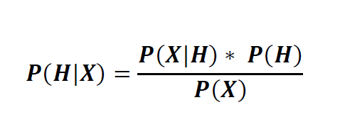
The formula for Bayes' Theorem is as follows:
Bayes' Theorem consists of two types of probabilities:
the posterior probability (P(H/X)) and
the prior probability (P(H)),
where X represents the data tuple and H represents a hypothesis(class Label).

Slide 6
Posterior probability:
P(H/X) is the posterior probability of hypothesis H conditioned on data tuple X.
For example, suppose we have data tuples from the fruits database described by the attributes color and shape, respectively, and that X is red color fruit with a shape of round. Suppose that H is the hypothesis that the fruit will an Apple.
Then the P(H/X) represents the probability of fruit X is Apple, considering the fruit’s color and shape information.

Slide 7
Prior probability:
P(H) is the prior probability of hypothesis H.
For example, this is the probability that any given fruit will be an Apple, regardless of color, shape, or any other information, for that matter.
i.e., The prior probability(H), is independent of data tuple X.

Slide 8
Similarly, P(X/H) is the posterior probability of X conditioned on hypothesis H. That is, it is the probability that a fruit, X, is red color and shape is round, given that we know the fruit will an Apple.
Similarly, P(X) is the prior probability of X. Using our example, it is the probability that a fruit from our data set of fruits is red color and round in shape.

Slide 9
Naive Bayes Classifier Algorithm:
It is a classification technique based on Baye’s Theorem and It is a simple Bayesian classifier.
For example, a fruit may be considered to be an apple if it is red, round, and about 3 inches in diameter.
Even if these features depend on each other, all of these properties independently contribute to the probability that this fruit is an apple and that is why it is known as “Naïve”.

Slide 10
Working of Naïve Baye’s Classifier:
This algorithm involves the following steps:
Step 1: Convert the given dataset into frequency tables.
Step 2: Generate Likelihood table by finding the probabilities of given features.
Step 3: Now, use Bayes theorem to calculate the posterior probability.

Slide 11
Example:
Suppose we have a dataset of weather conditions and corresponding target variable "Play". So, using the dataset we need to decide that whether we should play or not on a particular day according to the weather conditions
Problem: If the Weather is Sunny, then the Player should play or not?

Slide 12
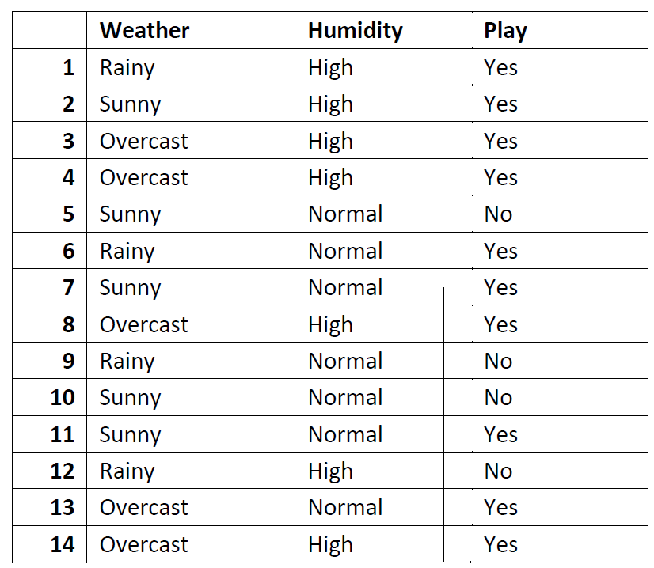
Data Set:

Slide 13
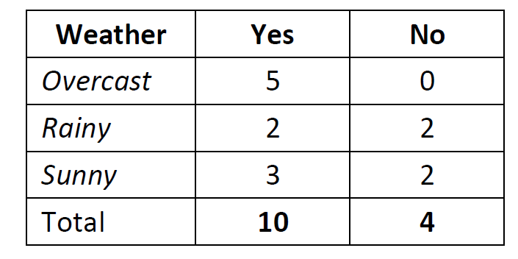
First, Convert the above dataset into frequency table as follows,

Slide 14
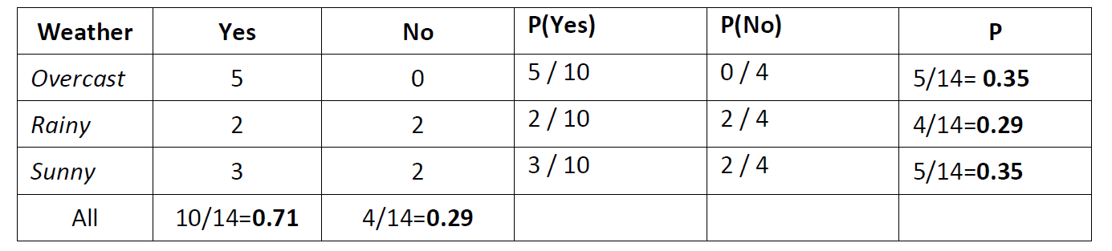
Next, Generate Likelihood table by finding the probabilities of given features as follows,

Slide 15
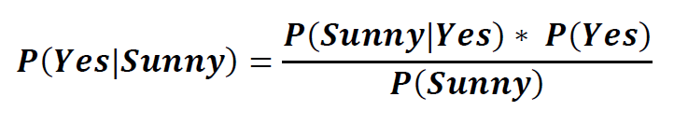
Applying Bayes' theorem:
If the data tuple(X) is Sunny, and the hypothesis(H) is Yes then the probability of Play is:

Slide 16
Where,
P(Sunny|Yes) = 3/10= 0.3
P(Yes)=10/14 = 0.71
P(Sunny)= 5/14 =0.35
Let us substitute the values in the above formula,
𝑷(𝒀𝒆𝒔|𝑺𝒖𝒏𝒏𝒚) = (𝟎.𝟑 ∗ 𝟎.𝟕𝟏) / 𝟎.𝟑𝟓
= 0.60
If the Weather is Sunny, then the probability of Play (Yes) is 0.60

Slide 17
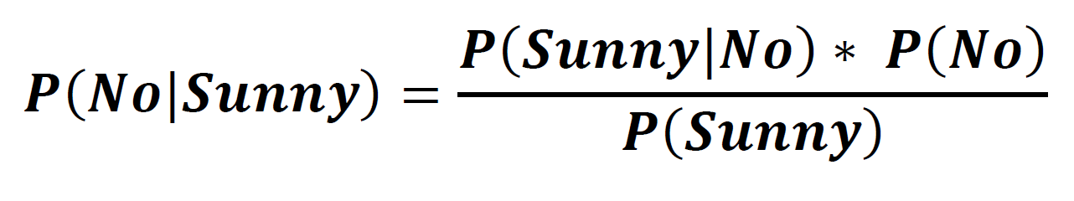
If the data tuple(X) is Sunny, and the hypothesis(H) is No then the probability of Play is:

Slide 18
Where,
P(Sunny|No) = 2/4 = 0.5
P(No) = 4/14 = 0.29
P(Sunny) = 5/14 = 0.35
Let us substitute the values in the above formula,
𝑷(𝑵𝒐|𝑺𝒖𝒏𝒏𝒚) = (𝟎.𝟓 ∗ 𝟎.𝟐𝟗) / 𝟎.𝟑𝟓
= 0.41
If the Weather is Sunny, then the probability of Play (No) is 0.41.

Slide 19
So, as we can see from the above calculation that P(Yes|Sunny) > P(No|Sunny)
Hence on a Sunny day, Player can play the game.
Exercise:
Problem: If the Weather is Sunny and Humidity is High, then the Player should play or not?

Slide 20

Solution:
If the data tuple(X) is (Sunny, High), and the hypothesis(H) is Yes then the probability of Play is :
If the data tuple(X) is (Sunny, High), and the hypothesis(H) is No then the probability of Play is :

