Slide 1
Create a MS ACCESS Database

Slide 2
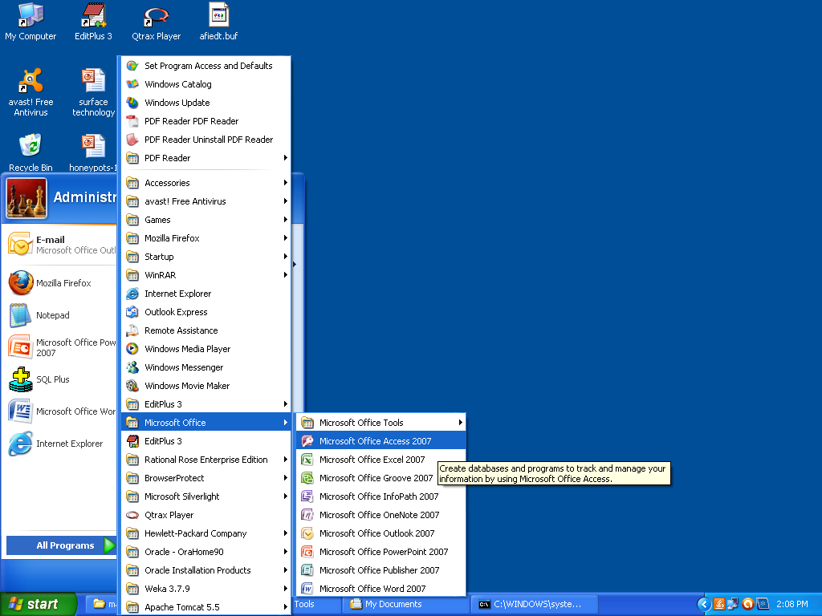

Slide 3
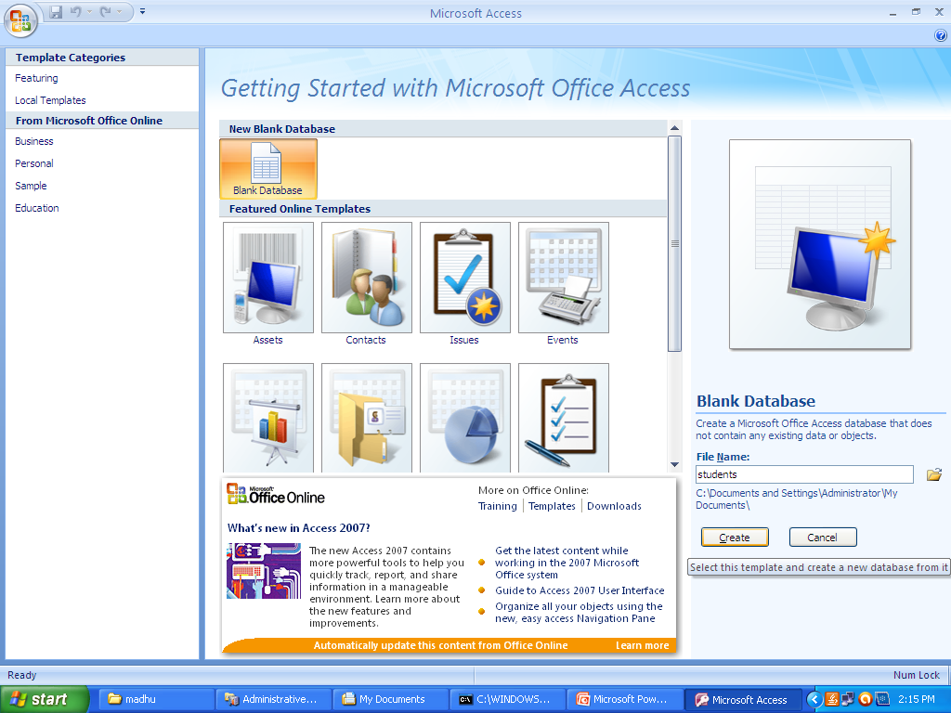

Slide 4
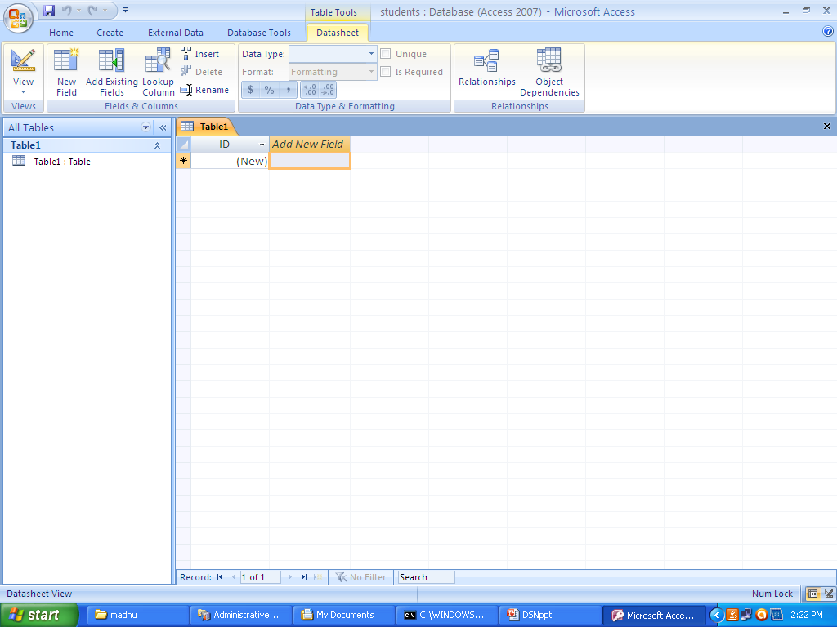

Slide 5
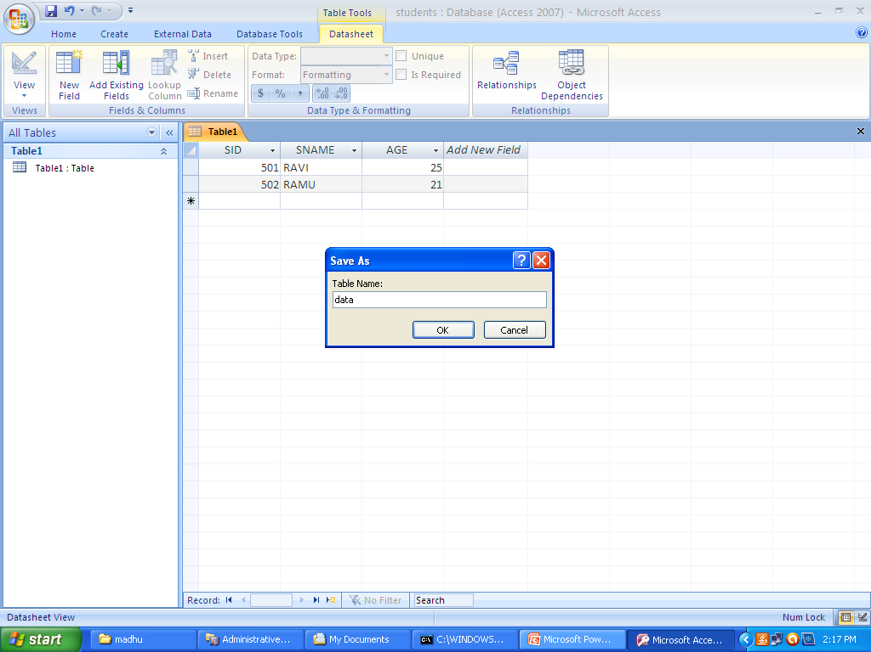

Slide 6
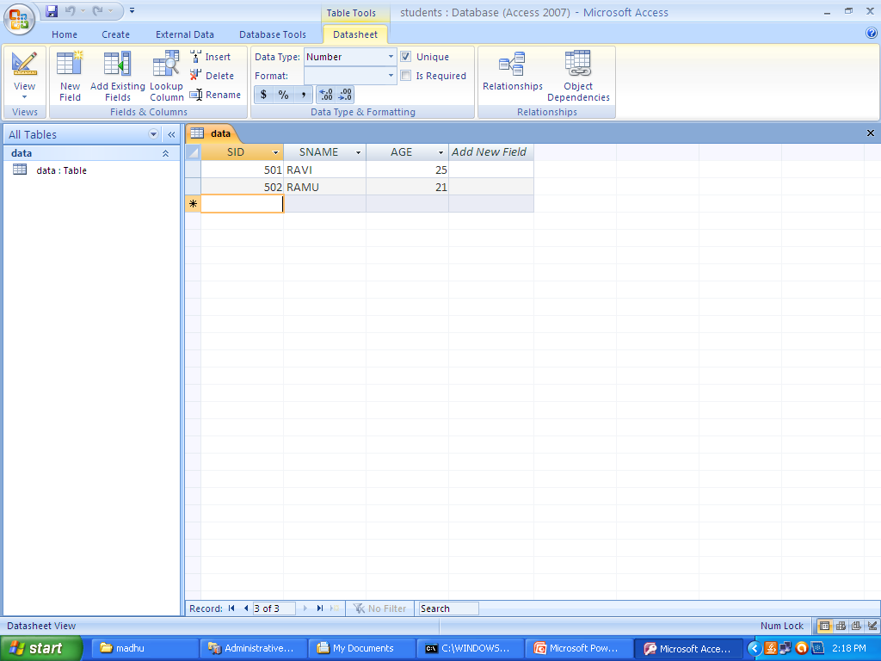

Slide 7
Finally Close the window.
Then start the process of creating DSN
DSN-Domain Server Name

Slide 8
CREATE A DSN FOR MS ACCESS DATABASE

Slide 9
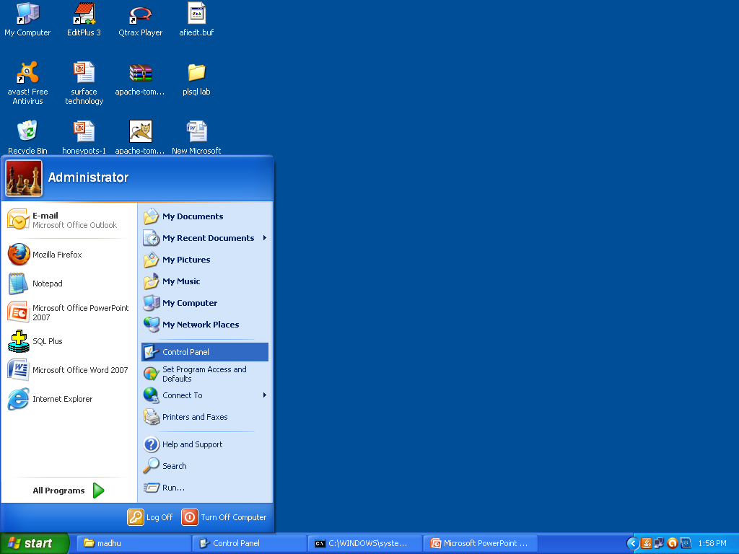

Slide 10
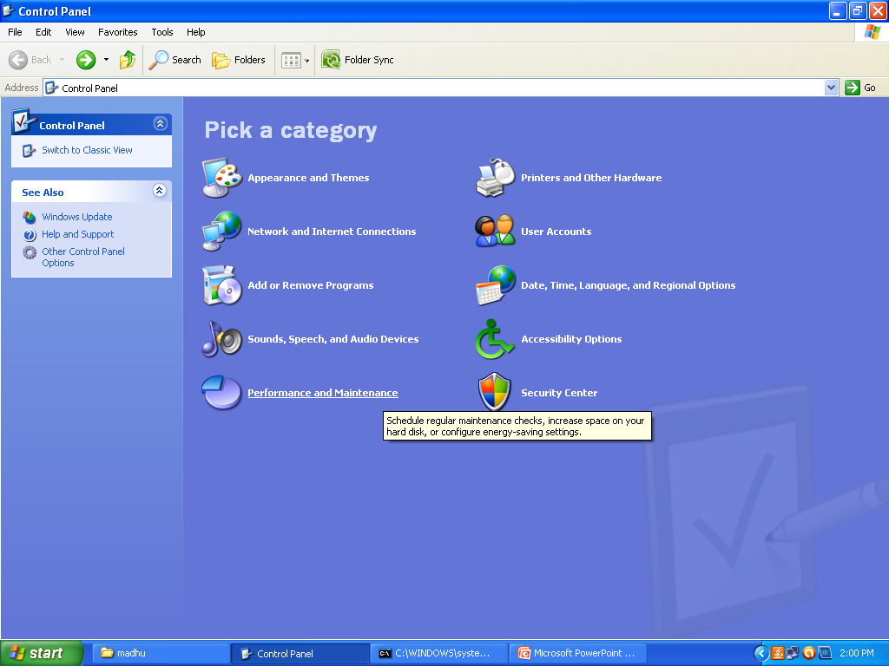

Slide 11
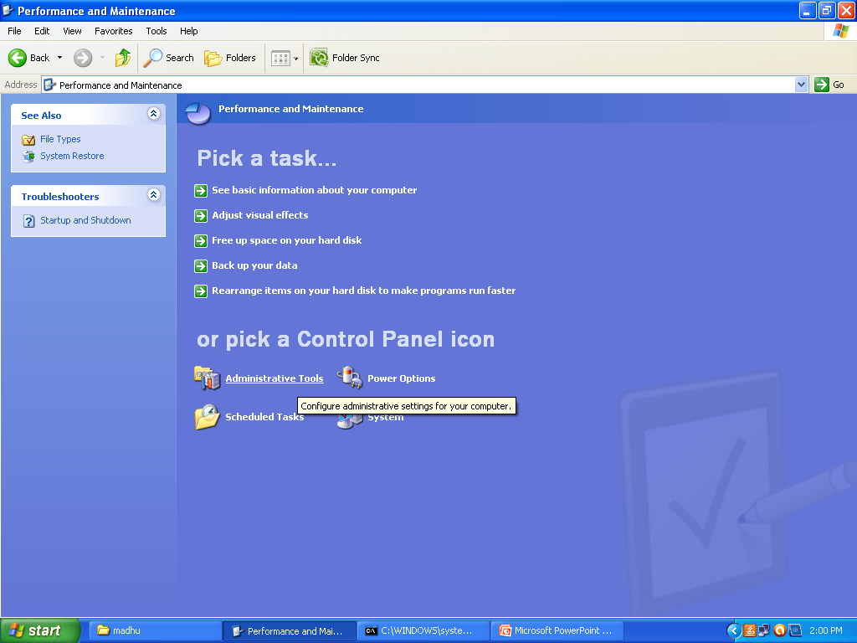

Slide 12
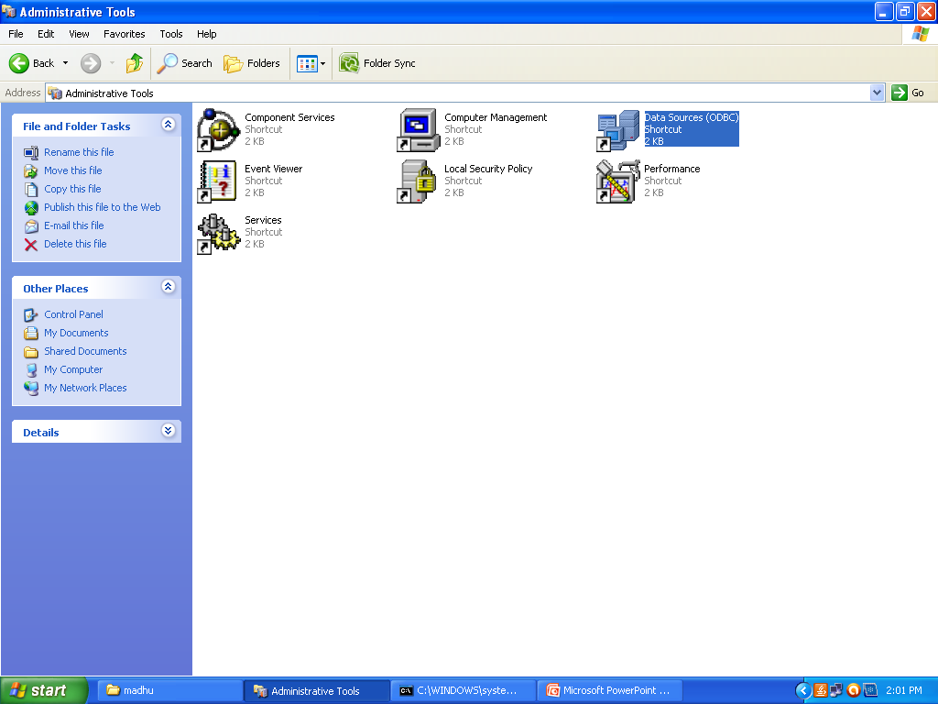

Slide 13
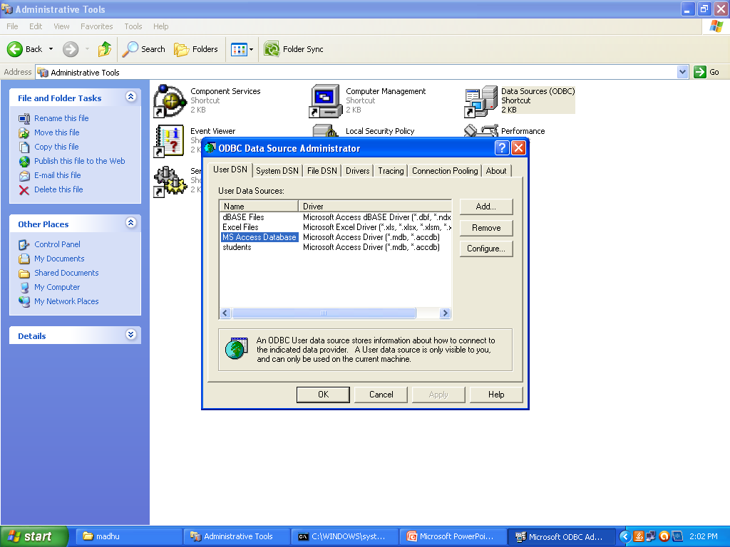

Slide 14
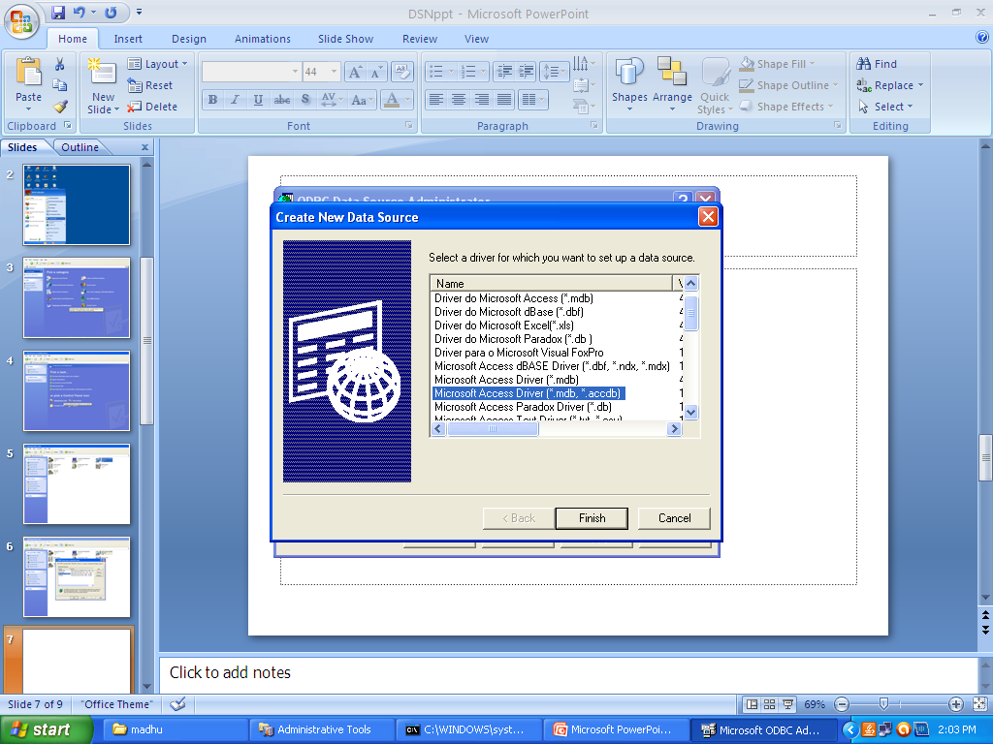

Slide 15
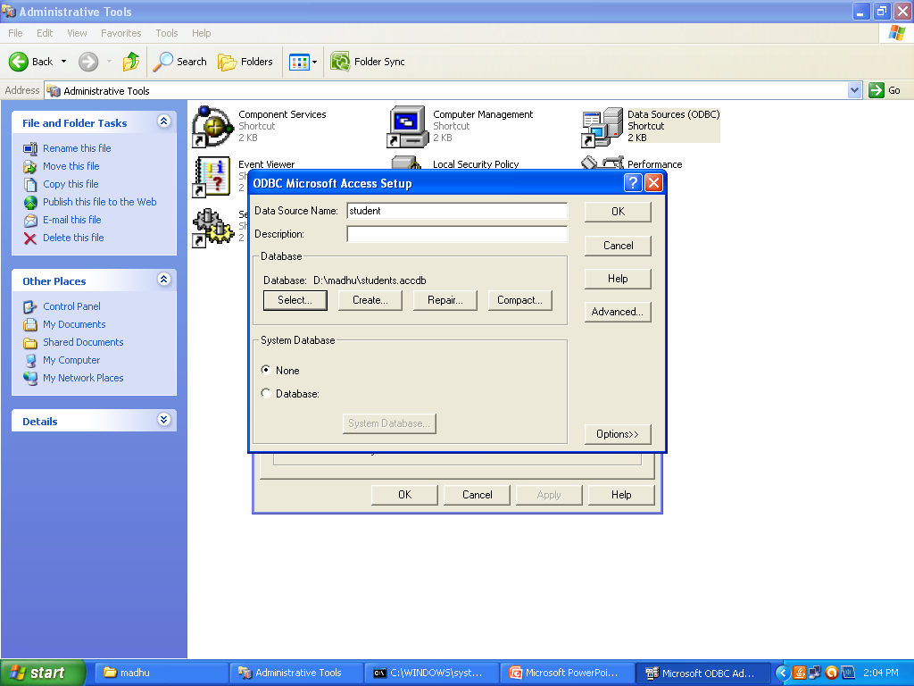

Slide 16
Finally..Click on the OK..and then ok
And then Execute your Program..
Thank u……….

