Slide 1
XML Validation
Document Type Definition (DTD)

Slide 2
XML – Validation
Validation is a process by which an XML document is validated.
An XML document with correct syntax is known as valid XML document.
Let’s see few important rules to check for syntax errors.
All XML documents must have a root element.
XML is a case sensitive language so you should be careful with the case while opening and closing tags.
All XML tags must have a closing tag.
XML attribute name should not be quoted while its value must be quoted.
There are two ways to check whether the XML document is valid.
XML DTD (Document Type Definition)
XML Schema

Slide 3
Document Type Definition (DTD)
  DTD stands for Document Type Definition. It is used to define document structure with a list of legal elements and attributes.
  Document Type Definition (DTD) is a certain piece of code, which can defines structure of XML document.
  Each DTD contains a list of elements, which specifies the rules for structuring a given XML document.
  Each DTD specifies the relationship between root element, child elements and sub child elements.
  An XML document is considered “well formed” and “valid” if it is successfully validated against DTD.

Slide 4
Document Type Definition (DTD) Contd..
  DTD’s are optional in XML, but recommended for clarity purpose.
  DTD’s can be declared internally (With in XML doc) and as an external file (with in a separate file with “.dtd” extension).
  Basic Building Blocks:
  There are 4 building blocks to build a XML document with DTD.
  those are
  1.Tags
  2.Elements
  3.Attributes
  4.Entities

Slide 5
Document Type Definition (DTD) Contd..
  1. Tags:
  The XML allows the user to create own tags.Useally the tag <tagname> is an Opening tag, </tagname> refers to its equivalent closing tag.
  Example:
  <book>Let us C</book>
  <author> Yashwant Kanetkar </ author >
  In XML the tags are case sensitive . And closing tag is mandatory.
  All the elements in XML should be properly nested and they should not overlap.

Slide 6
Document Type Definition (DTD) Contd..
  2. Elements in DTD:
  The DTD document is composed with various elements. These elements are used to represent the tags in XML document.
  Declaration:
  <!ELEMENT name-of-element(context)>
  To declare an empty element
  Syntax:
  <!ELEMENT name-of-element(EMPTY)>
  To declare an element, this carries data
  Syntax:
  <!ELEMENT name-of-element(#PCDATA)>
  (or)
  <!ELEMENT name-of-element(#CDATA)>

Slide 7
Document Type Definition (DTD) Contd..
  To declare an element, this contains child elements
  Syntax:
  <!ELEMENT name-of-element(child-names)>
  Examples:
  <!ELEMENT student(id,name,age)>
  <!ELEMENT name(#PCDATA)>
  <!ELEMENT age(EMPTY)>
  3.Attributes:
  These are used to provide the additional information along with elements.
  In DTD, the attributes are declared by using “ATTLIST” Keyword.
Syntax:
<! ATTLIST name-of-element name-of-attribute
attribute-type [default-value]>

Slide 8
Document Type Definition (DTD) Contd..
In the above syntax, the field ‘attribute-type’ can specifies the following pre-defined values.
ID:It is a value which remains unique.
CDATA: The value supplied here is nothing but character data.
ENTITY: The value supplied in this case is nothing but an entity.
In the same way, the filed ‘default-value’ can specifies the following pre-defined values.
  #REQUIRED: It means the value for the attribute is required.
  #IMPLIED: It means the attribute is not required.
  #FIXED: Here a fixed value is supplied.
  Default-value: It is a default value of given attribute.
Example:
<! ATTLIST student address CDATA #REQUIRED>

Slide 9
Document Type Definition (DTD) Contd..
4. Entities:
Some markup elements can contain complex data; these types of elements are called as Entities.
These are used to create small piece of data which you want you use repeatedly throughout your schema.
Syntax:
<! ENTITY name-of-entity “value”>
Example:
  <! ENTITY Book “Web Technologies”>
  Used as
  <author> the &Book author is Uttam K Roy</author>

Slide 10
Document Type Definition (DTD) Contd..
DTD’s can be declared internally (With in XML doc) and as an external file (with in a separate file with “.dtd” extension)
Example with external DTD:
Create a DTD for a remainder; it has following remainder as root element and child elements-heading, to, from, message.
“remainder.dtd”
<!ELEMENT remainder(heading,to,from,message)>
<!ELEMENT heading(#PCDATA)>
<!ELEMENT to(#PCDATA)>
<!ELEMENT from(#PCDATA)>
<!ELEMENT message(#PCDATA)>

Slide 11
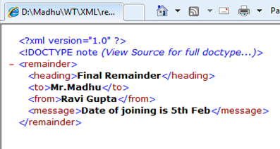
Document Type Definition (DTD) Contd..
“remainder.xml”
<?xml version="1.0"?>
<!DOCTYPE note SYSTEM "remainder.dtd">
<remainder>
<heading>Final Remainder</heading>
<to>Mr.Madhu</to>
<from> Ravi Gupta</from>
<message> Date of joining is 5th Feb</message>
</remainder>
Output:

Slide 12
Document Type Definition (DTD) Contd..
Example with internal DTD:
“remainderdemo.xml”
<?xml version="1.0"?>
<!DOCTYPE note [
<!ELEMENT remainder (heading,to,from,message)>
<!ELEMENT heading (#PCDATA)>
<!ELEMENT to (#PCDATA)>
<!ELEMENT from (#PCDATA)>
<!ELEMENT message (#PCDATA)>
]>
<remainder>
<heading>Final Remainder</heading>
<to>Mr.Madhu</to>
<from> Ravi Gupta</from>
<message> Date of joining is 5th Feb</message>
</remainder>

Slide 13
Document Type Definition (DTD) Contd..
Example:
Create a DTD for a catalog of four stroke engine motorbikes where each motor bike has the following child elements: make, model, year, color, engine, chassis number and accessories. The engine element has child elements those are – engine number, number of cylinders, type of fuel. The accessories elements has the attributes like disk break, auto start and radio, each of which required and has the possible values ‘YES’ and ‘NO’ . Entities must be declared for the names of the popular motorbike makes.

Slide 14
Document Type Definition (DTD) Contd..
“bikecatalog.dtd”
<!ELEMENT catalog (motorbike)*>
<!ELEMENT motorbike (make, model,year,color,engine, chasis_num, accessories)>
<!ELEMENT make (#PCDATA)>
<!ELEMENT model (#PCDATA)>
<!ELEMENT year (#PCDATA)>
<!ELEMENT color (#PCDATA)>
<!ELEMENT engine (engine_num,cylinder_num,fuel_type)>
<!ELEMENT engine_num (#PCDATA)>
<!ELEMENT cylinder_num (#PCDATA)>
<!ELEMENT fuel_type (#PCDATA)>
<!ELEMENT chasis_num (#PCDATA)>
<!ELEMENT accessories (#PCDATA)>
<!ATTLIST accessories diskbrake (Yes|No) #REQUIRED autostart (Yes|No) #REQUIRED radio (Yes|No) #REQUIRED>

Slide 15
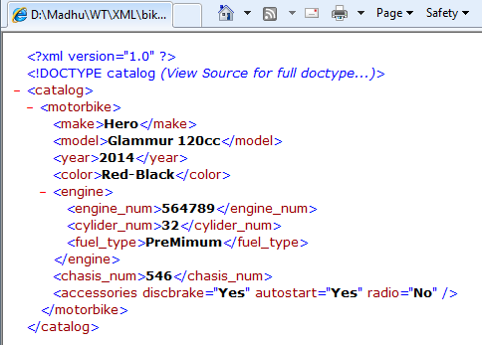
Document Type Definition (DTD) Contd..
<?xml version="1.0"?> “bikecatalog.xml”
<!DOCTYPE catalog SYSTEM "bikecatalog.dtd">
<catalog>
<motorbike>
<make>Hero</make>
<model>Glammur 120cc</model>
<year>2014</year>
<color>Red-Black</color>
<engine>
<engine_num>564789</engine_num>
<cylider_num>32</cylider_num>
<fuel_type>PreMimum</fuel_type>
</engine>
<chasis_num>546</chasis_num>
<accessories discbrake="Yes" autostart="Yes" radio="No"/>
</motorbike>
</catalog>

