Slide 1
Hierarchical Methods
(Agglomerative and Divisive)

Slide 2
Hierarchical clustering is another unsupervised learning algorithm, which is used to group the unlabeled datasets into a cluster.
The hierarchical clustering method works by combining data objects into a tree of clusters.
The result of hierarchical clustering is a tree-like structure, and this tree-like structure is known as the dendrogram, which illustrates the hierarchical relationships among the clusters.

Slide 3
Why hierarchical clustering?
We have seen in the partitioning clustering (eg: K-means) that there are some challenges with these algorithm, which are a predetermined number of clusters, and it always tries to create the clusters of the same size.
To solve these two challenges, we can opt for the hierarchical clustering algorithm because, in this algorithm, we do not need to have knowledge about the predefined number of clusters.

Slide 4
Types of Hierarchical Clustering:
Basically, there are two types of hierarchical Clustering:
Agglomerative Hierarchical Clustering (AHC)
  -It follows bottom-up approach
Divisive Hierarchical clustering (DHC)
-It follows top-down approach

Slide 5
Agglomerative Hierarchical Clustering

Slide 6
In this technique, initially each data point is considered as an individual cluster. At each iteration, the similar datapoints / clusters merge with other clusters until one cluster.
In other words, the Agglomerative clustering follows a bottom-up approach, it means, this algorithm considers each datapoint as a single cluster at the beginning, and then start combining the closest pair of clusters together. It does this until all the clusters are merged into a single cluster that contains all the datapoints.

Slide 7
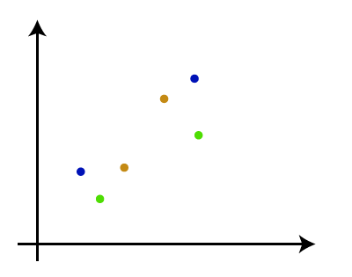
How the Agglomerative Hierarchical clustering Work?
The working of the AHC algorithm can be explained using the below steps:
Step-1: Create each data point as a single cluster. Let us say there are N data points, so the number of clusters will also be N.

Slide 8
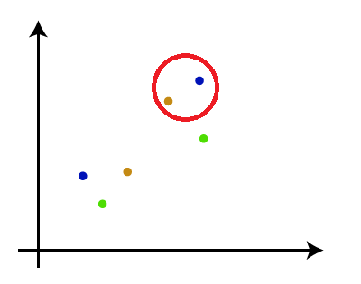
Step-2: Take two closest data points or clusters and merge them to form one cluster. So, there will now be N-1 clusters.

Slide 9
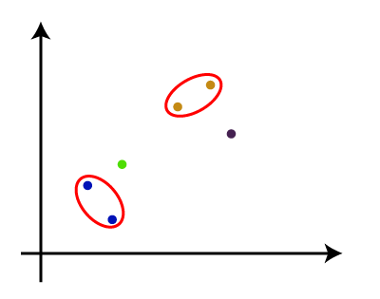
Step-3: Again, take the two closest clusters and merge them together to form one cluster. There will be N-2 clusters.

Slide 10
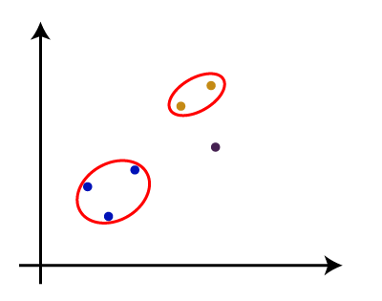
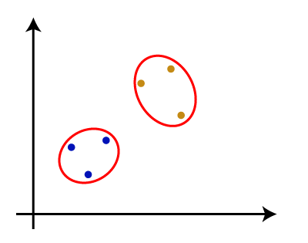
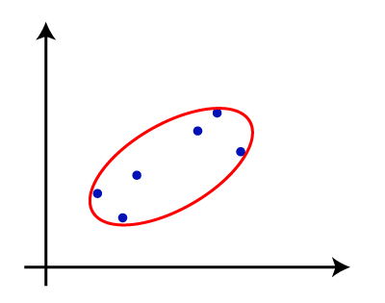
Step-4: Repeat Step 3 until only one cluster left. So, we will get the following clusters. Consider the below images:

Slide 11
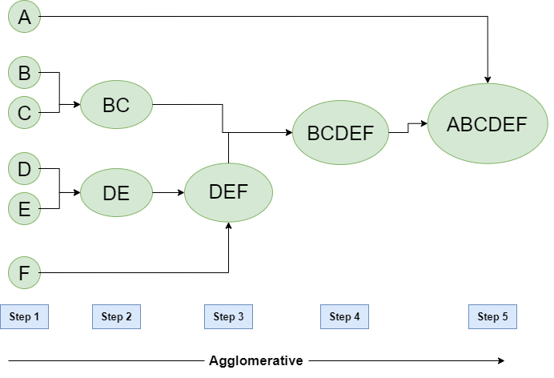
Example: Let us assume, we have six data points A, B, C, D, E, and F.

Slide 12
Divisive Hierarchical Clustering

Slide 13
In simple words, we can say that the Divisive Hierarchical clustering is exactly the opposite of the Agglomerative Hierarchical clustering.
In Divisive Hierarchical clustering, we consider all the data points as a single cluster and in each iteration, we separate the data points from the cluster which are not similar. Each data point which is separated is considered as an individual cluster. In the end, we’ll be left with N clusters.
The Divisive Hierarchical clustering follows a top - down approach.

Slide 14
How the Divisive Hierarchical clustering Work?
The working of the DHC algorithm can be explained using the below steps:
Step-1: Consider all the datapoints as a single cluster. Let us say there are N data points, so the number of clusters is 1.

Slide 15
Step-2: Separate the datapoints which are not similar into clusters. So, there will now be 2 clusters.

Slide 16
Step-3: Again, Separate the datapoints which are not similar into clusters. So, there will now be 3 clusters.

Slide 17
Step-4: Repeat Step 3 until left with N clusters. So, we will get the following clusters. Consider the below images :

Slide 18
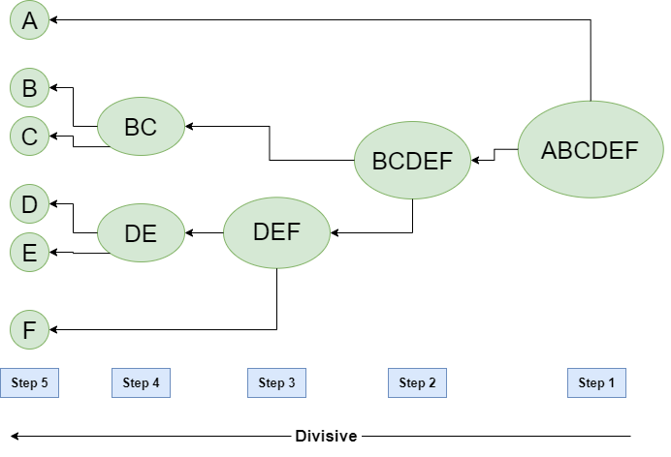
Example: Let us assume, we have six data points A, B, C, D, E, and F.

Slide 19
Measure for the distance between two clusters:
As we have seen, the closest distance between the two clusters is crucial for the hierarchical clustering.
There are various ways to calculate the distance between two clusters. These measures are called Linkage methods.
Some of the popular linkage methods are given below:

Slide 20
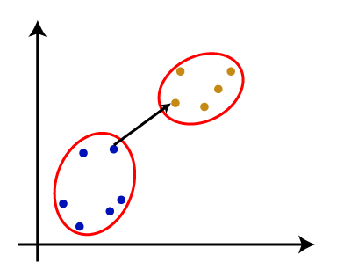
Single Linkage:
It is the Shortest Distance between the closest points of the clusters.

Slide 21
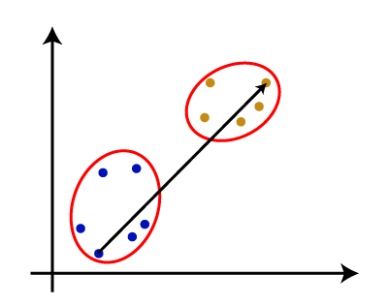
Complete Linkage:
It is the farthest distance between the two points of two different clusters. It is one of the popular linkage methods.

Slide 22
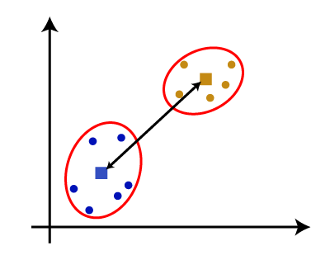
Centroid Linkage:
It is the linkage method in which the distance between the centroid of the clusters is calculated.

