Slide 1
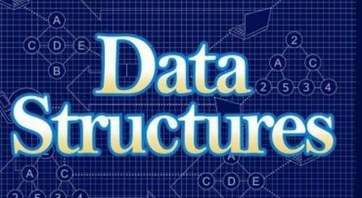
Introduction

Slide 2
Content
What is Data Structures?
Types of Data Structures.
Operations on data structures.

Slide 3
What is Data Structures?
Data Structures: Organizing large amount of data with more efficiently.
Storing the large amount of data in different structural format.
If we want to work with a huge amount of data, then organizing that data is very important.
If the data is not organized effectively, it is very difficult to perform any operation on that data.
If it is organized effectively then any operation can be performed easily on that data.

Slide 4
Types of Data Structures
Data Structures
Linear
Non-Linear

Slide 5
Linear Data Structures
If a data structure organizes the data in sequential order, then that data structure is called a Linear Data Structure.
Example
Arrays
Linked List
Stack
Queue

Slide 6
Non-Linear Data Structures
If a data structure organizes the data in random order, then that data structure is called as Non-Linear Data Structure.
Example
Trees
Graphs
Dictionaries
Heaps
Tries

Slide 7
Operations on data structures
Creation
Insertion
Deletion
Search

