Slide 1
XML Parsers
(DOM & SAX)

Slide 2
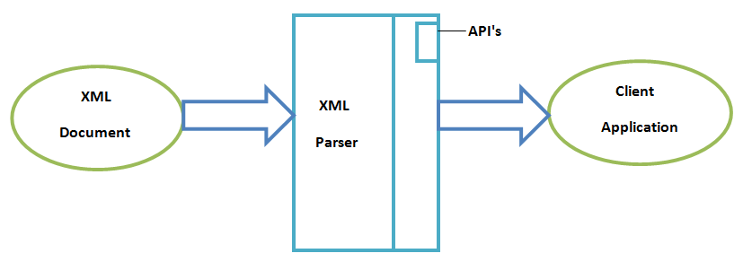
XML Parsers
  An XML parser is a software library or package that provides interfaces for client applications to work with an XML document.
  The XML Parser is designed to read the XML document and create a way(interface or API) for programs to use XML.

Slide 3
XML Parsers
Two Types of parsers
DOM Parser
SAX Parser

Slide 4
DOM (Document Object Model)
  DOM is a platform that allows programs and scripts to dynamically access and update the content and structure of a XML documents.
  The Document Object Model (DOM) is a programming API for HTML and XML documents. It defines the logical structure of documents and provides interface(API) for access documents.
  The Document Object Model can be used with any programming language.
  DOM exposes the whole document to applications.

Slide 5
DOM (Document Object Model)
  The XML DOM defines a standard way for accessing and manipulating XML documents. It presents an XML document as a tree-structure.
  The tree structure makes easy to describe an XML document. A tree structure contains root element (as parent), child element and so on.
  The XML DOM makes a tree-structure view for an XML document.
  We can access all elements through the DOM tree. We can modify or delete their content and also create new elements.

Slide 6
DOM (Document Object Model)
<?xml version="1.0"?>
<college>
<student>
<firstname>Durga</firstname>
<lastname>Madhu</lastname>
<contact>999123456</contact>
<email>dm@abc.com</email>
<address>
<city>Hyderabad</city>
<state>TS</state>
<pin>500088</pin>
</address>
</student>
</college>

Slide 7
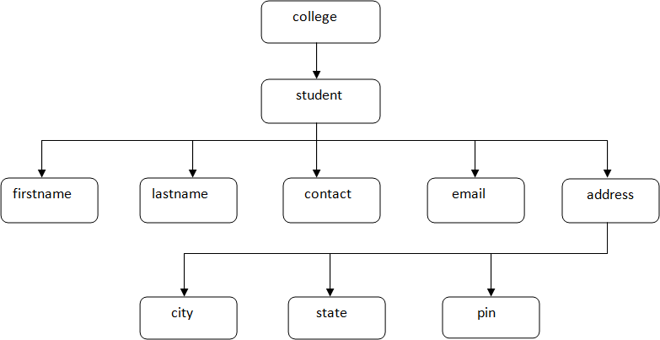
DOM (Document Object Model)
Let's see the tree-structure representation of the above example.

Slide 8
DOM (Document Object Model)
We need a parser to read XML document into memory and converts into XML DOM Object that can be accesses with any programming language (here we can use PHP).
The DOM parser functions are part of the PHP core. There is no installation needed to use these functions.
To load XML document in PHP
$xmlDoc = new DOMDocument();
this statement creates an object.
$xmlDoc->load("note.xml");
this statement loads a xml file by using object.

Slide 9
DOM (Document Object Model)
These are some typical DOM properties in php:
X -> nodeName - the name of X
X -> nodeValue - the value of X
X->parentNode - the parent node of X
X->childNodes - the child nodes of X
X->attributes - the attributes nodes of X
Where X is Node object.
“note.xml”
<?xml version="1.0" encoding="UTF-8"?>
<student>
<num>521</num>
<name>xyz</name>
<age>30</age>
</student>

Slide 10
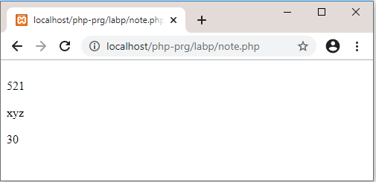
DOM (Document Object Model)
“Note.php”
<?php
$xmlDoc = new DOMDocument();
$xmlDoc->load("note.xml");
$x = $xmlDoc->documentElement;
foreach ($x->childNodes AS $item) {
print $item->nodeValue . "<br>";
}
?>
Output:

Slide 11
SAX
Simple API for XML

Slide 12
XML Parsers
What is an XML parser?
  An XML parser is a software library or package that provides interfaces for client applications to work with an XML document.
  The XML Parser is designed to read the XML and create a way for programs to use XML.

Slide 13
XML Parsers
Two types of parser
  SAX (Simple API for XML)
    Event driven API
    Sends events to the application as the document is read
  DOM (Document Object Model)
    Reads the entire document into memory in a tree structure

Slide 14
Simple API for XML

Slide 15
SAX Parser
When should I use it?
  Large documents
  Memory constrained devices
  If you need not to modify the document

Slide 16
SAX Parser
Which languages are supported?
  Java
  Perl
  C++
  Python

Slide 17
SAX Implementation in Java
Create a class which extends the SAX event handler
Import org.xml.sax.*;
import org.xml.sax.helpers.ParserFactory;
Public class SaxApplication extends HandlerBase {
public static void main(String args[]) {
}
}

Slide 18
SAX Implementation in Java
Create a SAX Parser
public static void main(args[]) {
String parserName = “org.apache.xerces.parsers.SAXParser”;
try {
SaxApplication app = new SaxApplication();
Parser parser = ParserFactory.makeParser(parserName);
parser.setDocumentHandler(app);
parser.setErrorHandler(app);
parser.parse(new InputSource(args[0]));
} catch (Throwable t) {
// Handle exceptions
}
}

Slide 19
SAX Implementation in Java
Most important methods to parse
  void startDocument()
    Called once when document parsing begins
  void endDocument()
    Called once when parsing ends
  void startElement(...)
    Called each time an element begin tag is encountered
  void endElement(...)
    Called each time an element end tag is encountered
  void error(...)
    Called once when parsing error occurred.

Slide 20
DOM | SAX
Tree model parser (Object based) (Tree of nodes). | Event based parser (Sequence of events).
DOM loads the file into the memory and then parse- the file. | SAX parses the file as it reads it, i.e. parses node by node.
Has memory constraints since it loads the whole XML file before parsing. | No memory constraints as it does not store the XML content in the memory.
DOM is read and write (can insert or delete nodes). | SAX is read only i.e. can’t insert or delete the node.
If the XML content is small, then prefer DOM parser. | Use SAX parser when XML content is large.
Backward and forward search is possible for searching the tags and evaluation of the information inside the tags. | SAX reads the XML file from top to bottom and backward navigation is not possible.
Slower at run time. | Faster at run time.

